Slide 1

GANDHINAGAR INSTITUTE OF TECHNOLGY
Design Engineering II A
Monthly Assessment II Presentation
Unique ID Management
Presented By
GIT_DE_2A_07
Sahil Panchal( 190120107080)
Vishwas Patel( 190120107112)
Kabir Shah( 190120107147)
Guided By
Prof. Sejal Bhavsar

Slide 2
Outline
Introduction
Empathy Canvas
AEIOU Canvas
Ideation Canvas
Product Development Canvas
Mind Mapping
Learning Need Matrix

Slide 3

Introduction of Domain
The Unique ID management is about maintaining a unique number for each and every citizen of the county. It will simplify the task of identity for an individual. Every citizen should have unique identification to find out personal information in each and every department or services wherever the citizen goes or do work. Unique identity can be provided with a birth certificate. After attaining age of 18 every citizen should be provided with a password to access the site which is assigned to apply for ID.

Slide 4
Empathy Canvas
It deals with the users, stakeholders, activities and story boarding

Slide 5
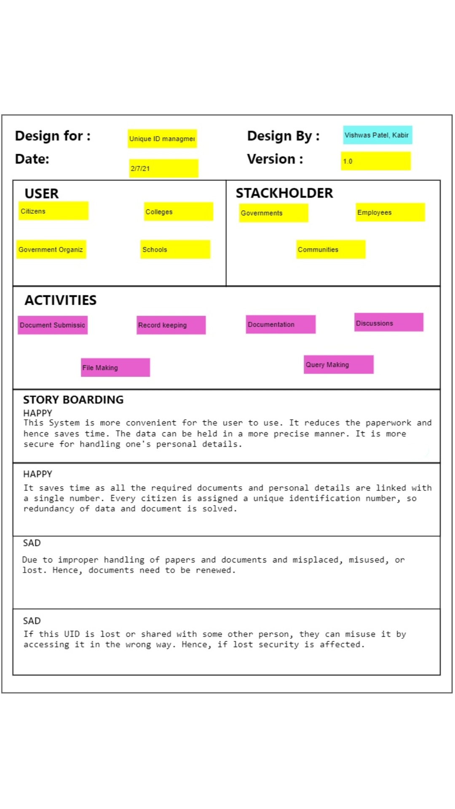

Slide 6
AEIOU Canvas
AEIOU is an investigative tool to help interpret observations gathered by ethnographic practices in the field. It is an Observation tool. Its two primary functions are to code data, and to develop building blocks of models that will ultimately address the objectives and issues of a client.
AEIOU stands for 5 elements to be coded:
Activity
Environment
Interaction
Objects
Users

Slide 7
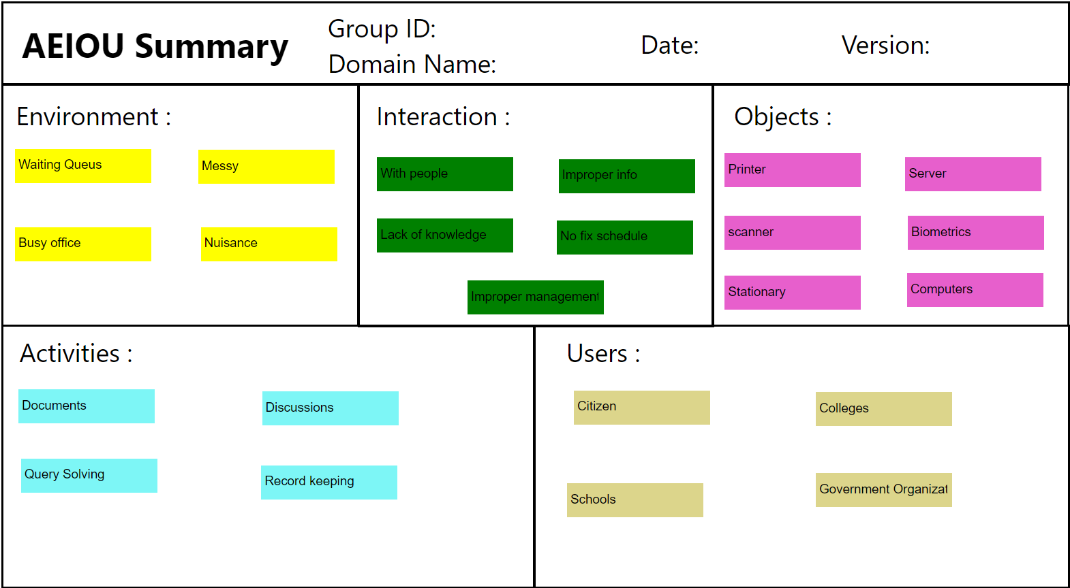

Slide 8
Ideation Canvas
Ideation canvas consists of activities that are done at that particular place during observation, people that were present involved in the activity, under what situation the observation and interaction was done with the people and at what location also what are the possible solutions that come to the mind.
Ideation Canvas deals with 4 things:
People
Activities
Situation/Context/Location
Props/Possible solution

Slide 9
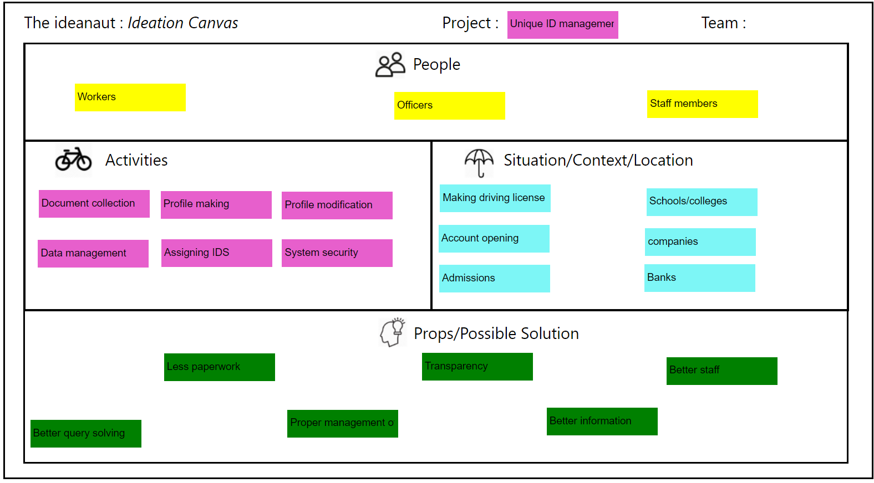

Slide 10
Product Development Canvas
Product development canvas deals with:
Purpose: Why the product was designed
People: For whom the product was designed
Product Experience: How was the product after using it for first time?
Product Function: What was the function of the product?
Product Feature: What are the features?
Components: What things were used to make the product?
Customer Revalidation: Testing is done here by the user for its proper functionality
Reject, Redesign, Retain: It consists of what things were rejected by the user, what changes are to be done and what things need not to be done.

Slide 11
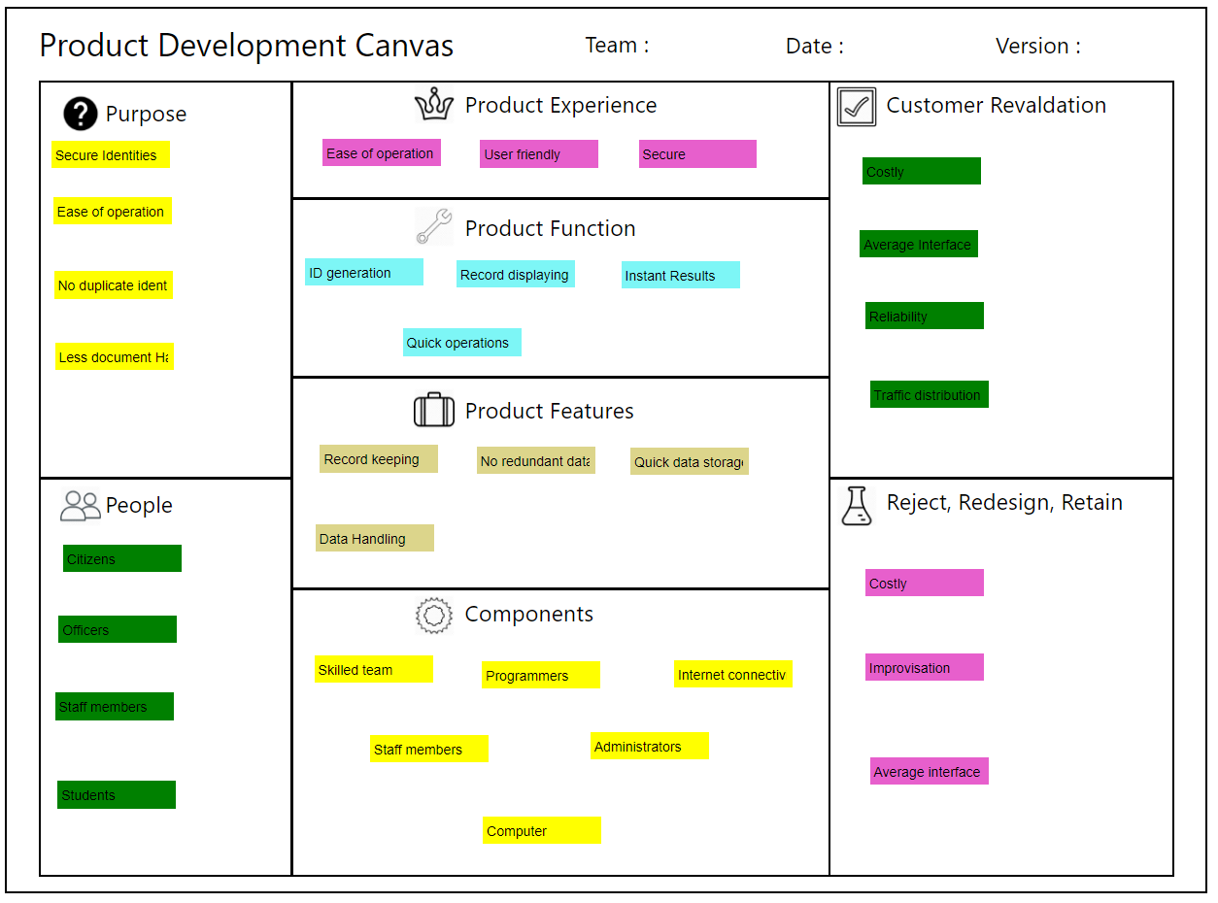

Slide 12
Mind Mapping
Mind mapping is the sheet on which all the thoughts are given a proper route and are classifies under specific headings based on the activities. It consists of all the random thoughts running through the mind when the topic name is heard

Slide 13
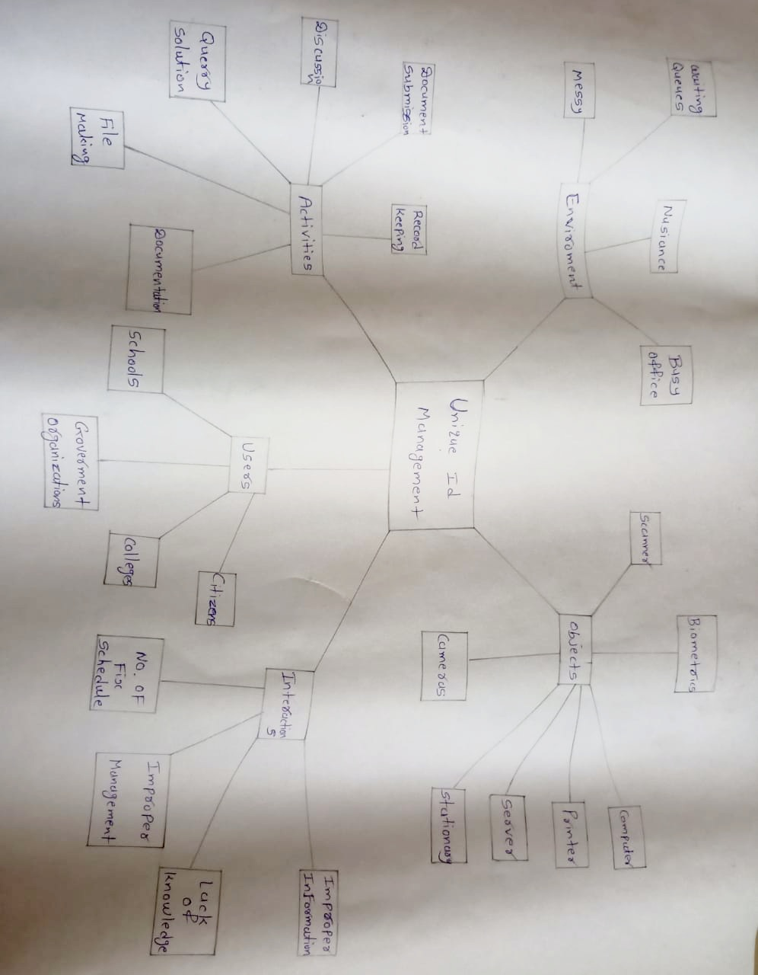

Slide 14
Learning Need Matrix
The purpose of LNM is to identify the requirements of learning among the team members. While a new product/process is under development based on a unique idea (to reduce the level of difficulty faced by a user), the team members need to learn and explore a lot of new skills and documents, methods and guidelines.
The LNM is containing a quadratic layout. From center (the concept under development), it needs to have mention of learning/exploring requirements in each quadrant representing a specific type of skill acquisition.

Slide 15
